Slide 1
Assignment: Linear Regression
SMRUTI RANJAN PARIDA

Slide 2
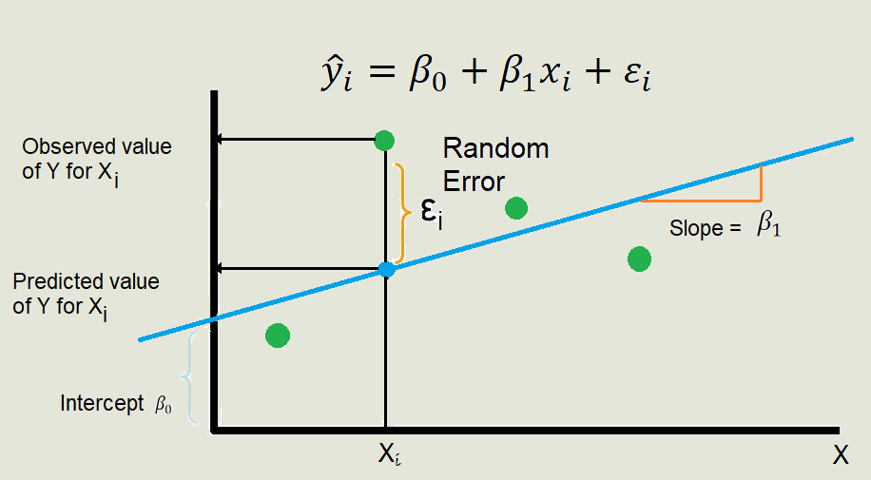
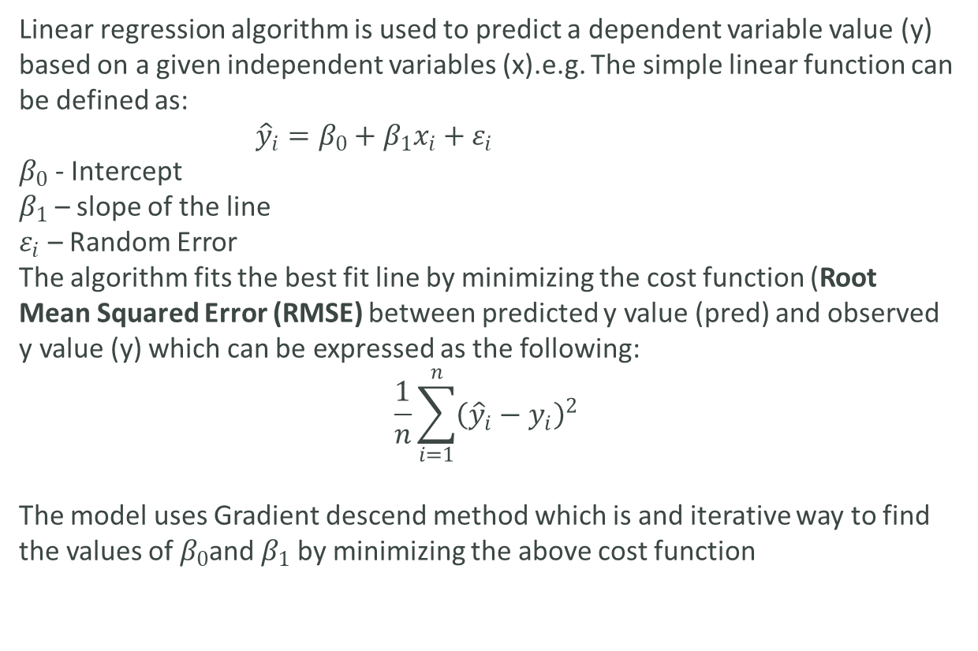
1. Linear regression algorithm in Detail
Linear regression algorithm is used to predict a dependent variable value (y) based on a given independent variables (x).e.g. The simple linear function can be defined as:
${\hat{y}}_{i}=β_{0}+β_{1}x_{i}+ε_{i}$
$β_{0}$ - Intercept
$β_{1}$ – slope of the line
$ε_{i}$ – Random Error
The algorithm fits the best fit line by minimizing the cost function (Root Mean Squared Error (RMSE) between predicted y value (pred) and observed y value (y) which can be expressed as the following:
$$\frac{1}{n}\sum_{i=1}^{n}{{\left({\hat{y}}_{i}−y_{i}\right)}^{2}}$$
The model uses Gradient descend method which is and iterative way to find the values of $β_{0}$and $β_{1}$ by minimizing the above cost function

Slide 3
2. Assumptions of linear regression regarding residuals
Assumptions for linear regression:
Dependent variable is continuous
Linear relationship between Dependent Variable and Independent Variable.
No Multicollinearity (no relationship between Independent variables)
Residuals should follow Normal Distribution with mean as 0.
Residuals should have constant variance: Homoscedasticity
Residuals should be independently distributed/no autocorrelation

Slide 4
3. coefficient of correlation and the coefficient of determination
Coefficient of Correlation: is the degree of relationship between two variables say x and y. It can go between -1 and 1. 1 indicates that the two variables are moving in unison. They rise and fall together and have perfect correlation. -1 means that the two variables are in perfect opposites. If the variables are not correlated then the correlation value can still be computed which would be 0.
Coefficient of determination: R square or coefficient of determination shows percentage variation in y which is explained by all the x variables together. Higher the better. It is always between 0 and 1. In case of simple linear regression Coefficient of Determination is the square of Coefficient of Correlation.

Slide 5
4. Anscombe’s quartet
Anscombe’s Quartet comprises four datasets, each containing eleven pairs which share the same descriptive statistics .
Dataset I appears to have clean and well-fitting linear models. Dataset II does not have a linear correlation. Dataset III does, but the linear regression is thrown off by an outlier. Dataset IV, finally, does not fit any kind of linear model
The summery statistics doesn’t always gives the complete picture of the data set. This quartet emphasizes the importance of visualization in Data Analysis. Looking at the data reveals a lot of the structure and a clear picture of the dataset.
Data Set | I |  | II |  | III |  | IV
SUM | 99 | 82.51 | 99 | 82.51 | 99 | 82.5 | 99 | 82.51
MEAN | 9 | 7.5 | 9 | 7.5 | 9 | 7.5 | 9 | 7.5
S.DEV | 3.32 | 2.03 | 3.32 | 2.03 | 3.32 | 2.03 | 3.32 | 2.03

Slide 6
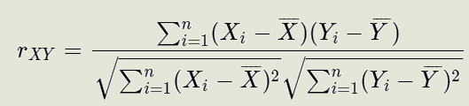

5. Pearson’s R
The Pearson R is a measure of the strength of the linear relationship between two continuous variables when it is measured in a sample.
Pearson's r can range from -1 to 1. An r of -1 indicates a perfect negative linear relationship between variables, an r of 0 indicates no linear relationship between variables, and an r of 1 indicates a perfect positive linear relationship between variables
Pearson correlation between two variables X and Y is calculated as:

Slide 7
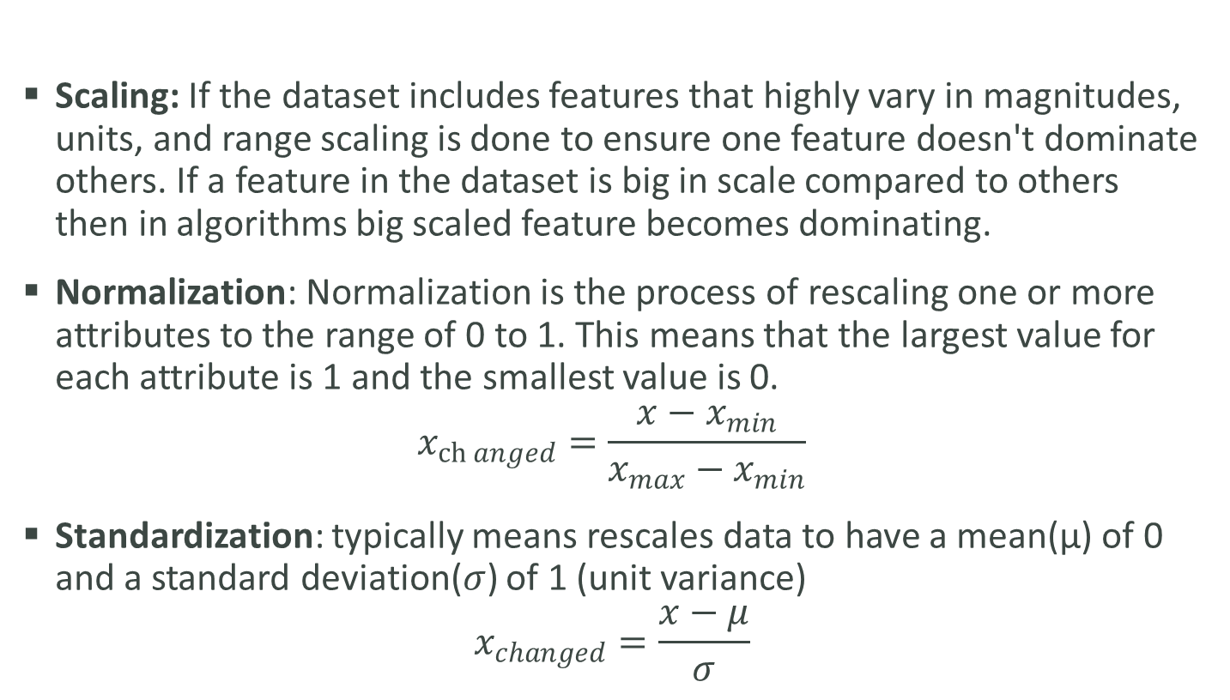
6. Normalized scaling and standardized scaling
Scaling: If the dataset includes features that highly vary in magnitudes, units, and range scaling is done to ensure one feature doesn't dominate others. If a feature in the dataset is big in scale compared to others then in algorithms big scaled feature becomes dominating.
Normalization: Normalization is the process of rescaling one or more attributes to the range of 0 to 1. This means that the largest value for each attribute is 1 and the smallest value is 0.
$$x_{\operatorname{ch}{anged}}=\frac{x−x_{min}}{x_{max}−x_{min}}$$
Standardization: typically means rescales data to have a mean(µ) of 0 and a standard deviation($σ$) of 1 (unit variance)
$$x_{changed}=\frac{x−μ}{σ}$$
Example:

Slide 8
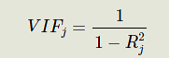
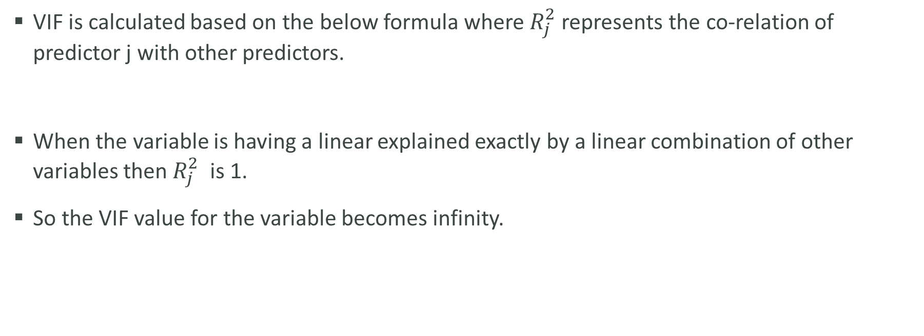
7. Infinite VIF
VIF is calculated based on the below formula where $R_{j}^{2}$ represents the co-relation of predictor j with other predictors.
When the variable is having a linear explained exactly by a linear combination of other variables then $R_{j}^{2}$ is 1.
So the VIF value for the variable becomes infinity.

Slide 9
8. Gauss markov theorem
under certain conditions, the ordinary least squares (OLS) estimator of the coefficients of a linear regression model is the best linear unbiased estimator (BLUE), that is, the estimator that has the smallest variance among those that are unbiased and linear in the observed output variables.
Assumptions
Linearity: the parameters we are estimating using the OLS method must be themselves linear.
Random: our data must have been randomly sampled from the population.
Non-Collinearity: the regressors being calculated aren’t perfectly correlated with each other.
Exogeneity: the regressors aren’t correlated with the error term.
Homoscedasticity: no matter what the values of our regressors might be, the error of the variance is constant.

Slide 10
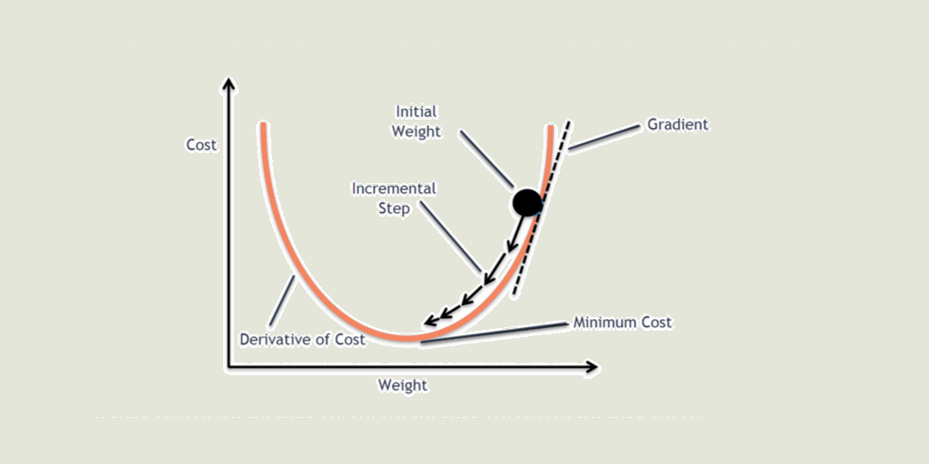
9. Gradient descent algorithm
Gradient descent is an optimization algorithm used to minimize the cost function by iteratively moving in the direction of steepest descent as defined by the negative of the gradient. In machine learning, we use gradient descent to update the parameters of our model. Parameters refer to coefficients in Linear Regression.
We use partial derivatives of the cost function with respect to each parameter and store the results in a gradient. This gradient provide the slope of our cost function at our current position (current parameter values) and the direction we should move to update our parameters. The size of our update is controlled by the learning rate which can be very small like 0.0001for good accuracy. We repeat this process until our loss function is a very small value or ideally 0 (which means 0 error or 100% accuracy). The value of m and c that we are left with now will be the optimum values

Slide 11
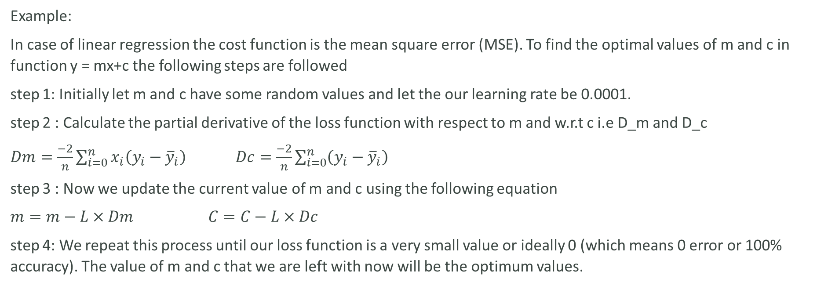
9. Gradient descent algorithm Cont..
Example:
In case of linear regression the cost function is the mean square error (MSE). To find the optimal values of m and c in function y = mx+c the following steps are followed
step 1: Initially let m and c have some random values and let the our learning rate be 0.0001.
step 2 : Calculate the partial derivative of the loss function with respect to m and w.r.t c i.e D_m and D_c
$Dm=\frac{−2}{n}\sum_{i=0}^{n}{x_{i}\left(y_{i}−{\overline{y}}_{i}\right)}$ $Dc=\frac{−2}{n}\sum_{i=0}^{n}{\left(y_{i}−{\overline{y}}_{i}\right)}$
step 3 : Now we update the current value of m and c using the following equation
$m=m−L×Dm$ $C=C−L×Dc$
step 4: We repeat this process until our loss function is a very small value or ideally 0 (which means 0 error or 100% accuracy). The value of m and c that we are left with now will be the optimum values.

Slide 12
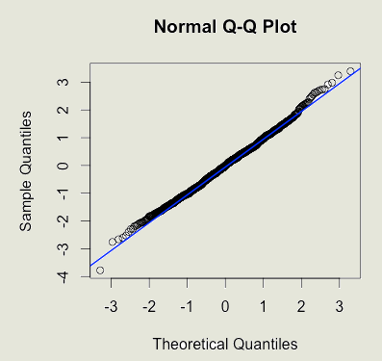
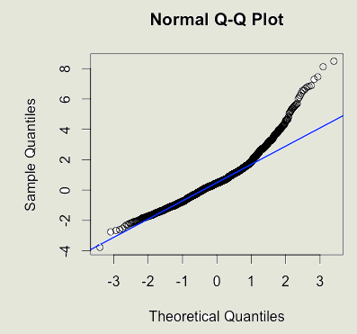
10: Q-Q plot
The quantile-quantile or q-q plot is an exploratory graphical device used to check the validity of a distributional assumption for a data set. The plot is constructed by Plotting the first data set’s theoretical Quantiles along the x-axis and plotting the Sample Quantiles along the y-axis to check if the quantiles match.
If the data indeed follow the assumed distribution, then the points on the q-q plot will fall approximately on a straight line.
The basic assumptions in linear regression is that the distribution of the residuals are normally distributed with mean of 0. if residuals are normally distributed then the points on the QQ plot will fall on a straight line. In case it is not in a straight line then the assumption that the residuals are normally distributed is false.
Examples:
Normal
Distribution
Right skewed
Distribution

